Slide 1
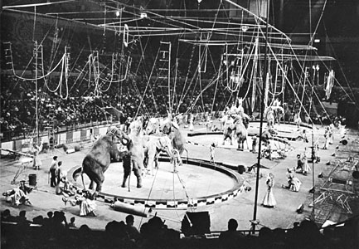
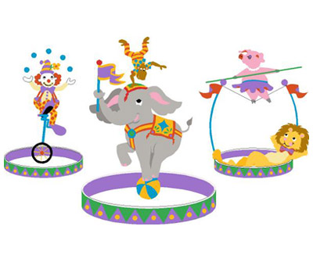
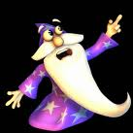
It’s Witch Hunting Season
Amy, Rebecca, and Devin

Slide 2
Important Facts
Initial Velocity: 30 m/s
Initial Velocity in the X Direction: 10.26 m/s
Initial Velocity in the Y Direction: 28.19 m/s
Displacement of X: 59.03m
Time: 5.753 s
Height at Peak of Trajectory: 42.5m

Slide 3
It’s a three ring circus!
And we propose YOU use a theme that uses three rings as well! Get out your Quidditch hoops, your wizard suit, and get ready to recreate the most famous magical locations in the world – then get your audience in on the action as they perform physics to save Merlin!
***We recommend planting a fake audience member who knows the answer to ensure that your costumed Merlin comes to no harm.

Slide 4
Scenario
It’s Witch Hunting Season in Mordor and Hogwarts has been compromised! The village elders have instituted a new death penalty for witches by shooting them through a flaming quidditch hoop, because witches and wizards never receive science education. To make it fair, if Merlin can figure out how to land on the net the elders have kindly provided, they will end Witch Hunting season immediately for the next hundred years (time is different in Mordor). Merlin uses his “phone a friend” lifeline, and wants your help! If you can set all of the parameters correctly, Merlin will survive being a human cannonball and Witch Hunting Season will be over for a century!

Slide 5
Problem
The Cannon is set at a 70° angle. It launches two feet above the ground. Merlin’s net will also be held two feet above the ground.
Knowing that the flaming hoop Merlin must pass through is at 42.5 meters and that he has an initial velocity of 30 meters per second, in how far away from the launch point should Merlin position the net?

Slide 6
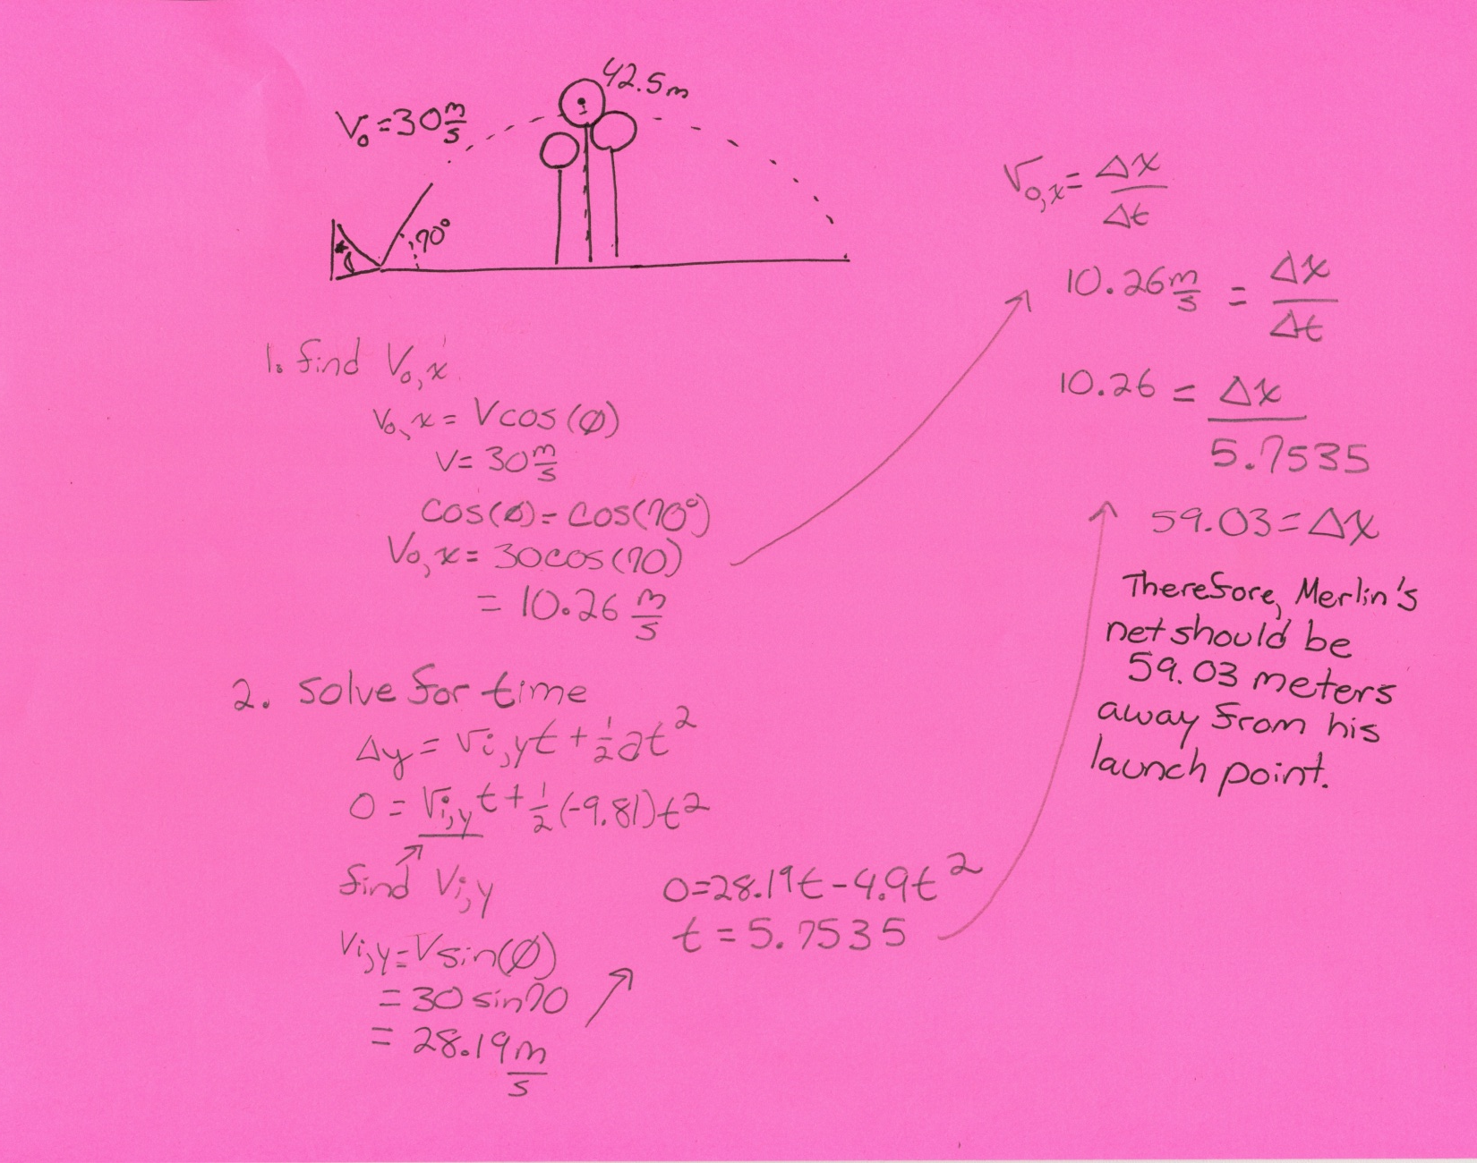
Solution

Slide 7
Now try it in real life!
We’re bringing you this new circus for just one low payment! Pay for the schematics and a list of necessary products and costumes, and then all you have to do is buy a cannon, quidditch hoops, theme materials, and a net!
Create your circus around our theme: The Human Cannonball: Witch Hunting Season

Slide 8
Check out our SCRATCH animation and see Merlin perform impossible feats while saving his fellow Mordorians from Witch Hunting Season!

